Slide 1
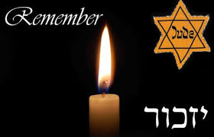
The Holocaust

Slide 2
What do you know about the Holocaust?
Know | Want to Know | Learned

Slide 3
What is the Holocaust?
The Holocaust was the planned and organized murder of six million Jews and millions of others by the Nazis and their collaborators during World War II
Included in this six million are an estimated 1.5 million children who were murdered by the Nazis.
1933-1945
Genocide = violence against members of a national, ethnic, racial or religious group with the intent to destroy the entire group.

Slide 4
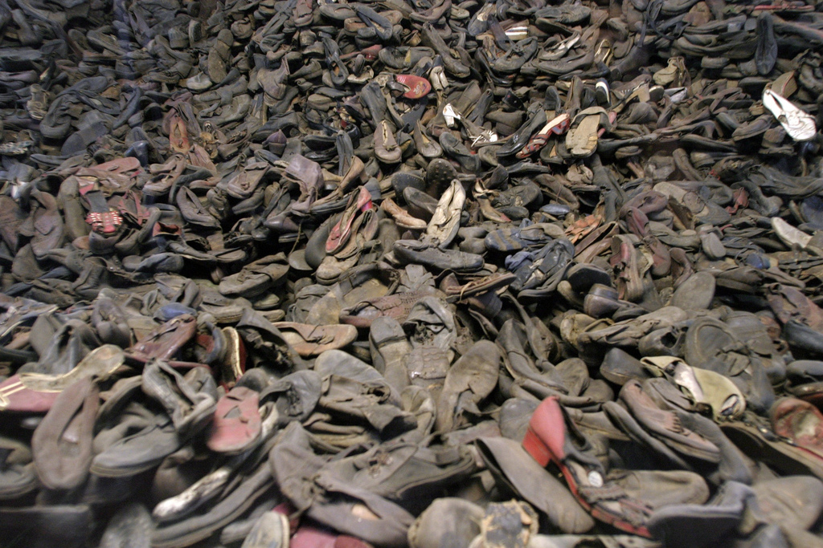

Slide 5
Who else did the Nazis persecute?
During the era of the Holocaust, German authorities also targeted and murdered other groups because of their perceived "racial inferiority“ or for political reasons:
Roma (Gypsies)
the mentally and physically disabled
Jehovah's Witnesses, and
Homosexuals
Communists, Socialists, and political dissidents
Some of the Slavic peoples (Poles, Russians, and others).
People of African origin

Slide 6
Who were the Nazis?
The Nazi Party was a political party that took power in Germany in 1932
Nazi stands for the National Socialist Workers Party.
Leader – Adolf Hitler
Nazis believed that Germans were the superior race and that all other people were inferior
Hitler was a fanatical anti-Semite.
Anti-semitism = Hatred, prejudice, or discrimination against Jews.
He blamed all of Germany’s problems on the Jewish people
He said that Germany must destroy the Jews

Slide 7
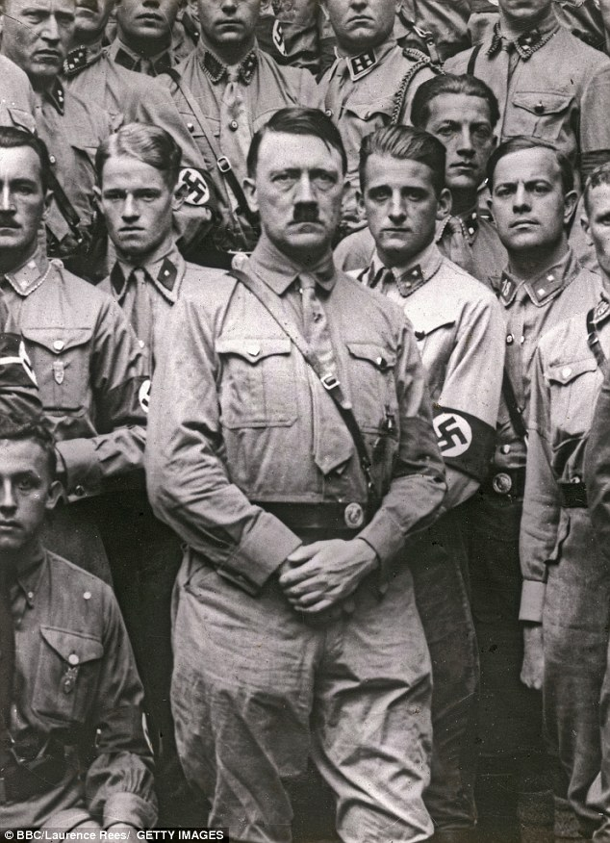
Hitler

Slide 8
The Nazis Come to Power
In 1932, Germany voted the Nazi Party into power democratically
Germany was in the Great Depression and they were looking for someone to blame
They bought into the anti-Semitic propaganda and lies spread by Hitler and the Nazi Party.
Once in power, Hitler took complete power, dismantled Germany’s democratic system and appointed himself Chancellor for Life
He called himself the “Fuhrer”, the “leader”.
He became a dictator.
As dictator, Hitler used violence to get rid of anyone who opposed him
He used the SS and the Gestapo, his special army and secret police, to enforce his views.

Slide 9
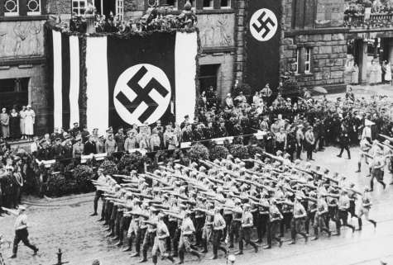
A Nazi parade

Slide 10
Nazi Racial Ideology
Adolf Hitler and the Nazis wanted to create a master race of Germans.
They called the master race the Aryans.
To the Nazis, the “perfect Aryan” had blonde hair, blue eyes, and light skin.
They were supposed to be tall and strong.
They thought all other people and races were inferior
Look at a photograph of Adolf Hitler. Does he look like a perfect
Aryan to you?

Slide 11
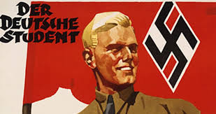
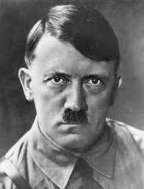

Slide 12
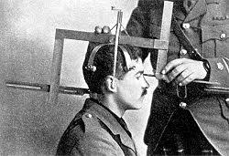
Racial Theory

Slide 13
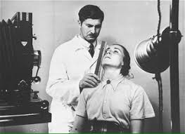

Slide 14
Nazi control of Germany
Hitler and the Nazis took away people’s rights:
Nazi police could read anyone’s mail, listen to their telephone
calls, and search their homes.
People who spoke out against the Nazis were called enemies of
the state. Some people were sent to makeshift prisons called
concentration camps.
Books “enemies” wrote were burned.
Many people were hurt or killed.

Slide 15
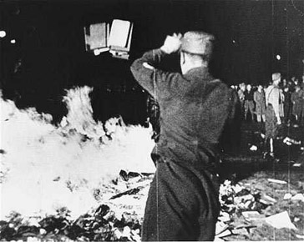
Book burning

Slide 16
Why did so many Germans follow Hitler?
Hitler promised to restore German pride and improve its economy after its crushing defeat in WWI
They told Germans that they were superior.
The Nazis paraded through towns with their flags. They made it seem
exciting to be a Nazi.
The radio stations and newspapers were controlled by the Nazis. They
played Nazi songs. They told how wonderful Adolf Hitler and the Nazis
were.
Even the children were supposed to join the “Hitler Youth,” a club that taught them how to be Nazis.
Many Germans already had underlying anti-semitic feelings.

Slide 17
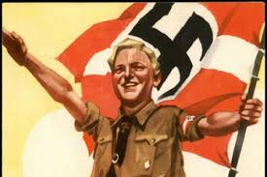
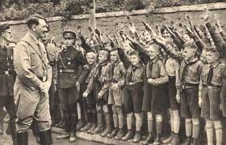
Hitler Youth

Slide 18
Nazi Propaganda
They convinced some Germans that people who were different were subhuman.
This term meant that they were considered “less than human.”
They used posters and movies, and the mass media, like radios and newspapers, to hurt certain groups of people.
The Nazis used a lot of propaganda to gain support from the German people.

Slide 19
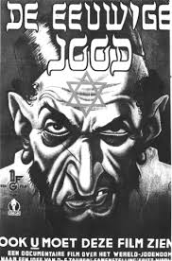
Anti-semitic Propaganda

Slide 20
The Nuremberg Laws, 1938
Citizenship was revoked
Kicked out of public schools
Doctors, lawyers, or people who owned businesses were forbidden to do their work.
Park benches and the beaches had signs saying, “No Jews Allowed.”
Jews cannot vote, own property, operate a business, or be paid wages as employees.

Slide 21
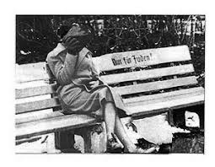
Park bench marked “For Jews only”

Slide 22
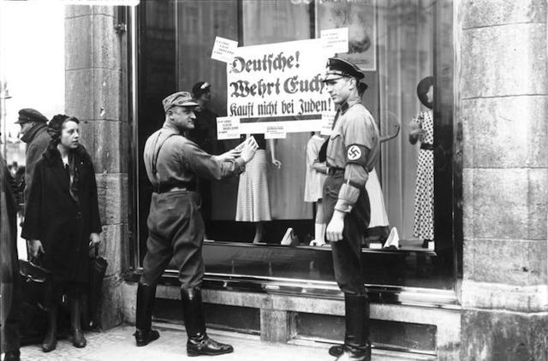
Boycotts of Jewish Businesses

Slide 23
Kristallnacht, the Night of Broken Glass - November 1938
In November 1938, things worsened as the Nazi government began to use violence against Jewish people, instead of just passing laws and saying bad things.
For two days all over the country, they destroyed Jewish businesses, and burnt down the Jewish places of worship, called synagogues.
Homes were broken into. People were beaten. About 30,000 people were arrested, and many were never seen again.
Every Jewish person was in danger: children and old people, women and men, rich people and poor.
These two days are now called Kristallnacht, the “Night of Broken Glass.”

Slide 24
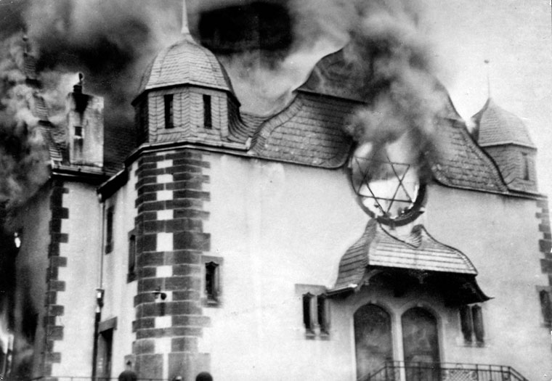
Synagogues burned all over Germany

Slide 25
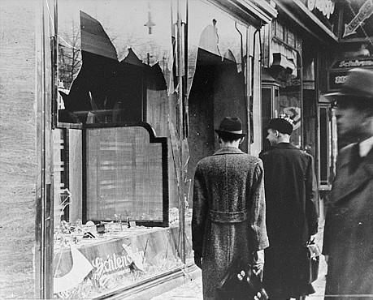
Jewish store windows smashed and looted

