Slide 1
Argumentative Writing
Informative Writing
FSA Writing Handbook
Name
February 26, 2018
Period
Grammar & Punctuation
Transition Phrases
Expanding Vocabulary

Slide 2
Informative Writing
Planning Format
I- Introduction
T1- Topic 1
T2- Topic 2
T3- Topic 3
C- Conclusion
Writing Format
Introduction- Hook/Audience Grabber
(at least 5 sent.) Topic Sentence
Introduce 3 main topics
Closing Sentence
T Paragraphs- Topic Sentence
(T1, T2, T3) 4-5 sentences about A
4-5 sentences about B
Closing Sentence
Conclusion- Topic Sentence
Review 3 main topics
Thought/Feeling
Closing Sentence
Dos and Don’t’s:
Do:
Inform and give facts.
Elaborate on details.
Cite text evidence.
Don’t:
Give opinion statements.
Address the audience directly.
Talk about yourself.

Slide 3
Argumentative Writing
Planning Format
I- Introduction
R1- Reason 1
R2- Reason 2
R3- Counterclaim/rebuttal
C- Conclusion
Writing Format
Introduction- Hook/Audience Grabber
(at least 5 sent.) Claim Sentence/Thesis (Introduce 3 reasons)
Closing Sentence
R Paragraphs- Main Idea Sentence (Reason 1, 2, or 3)
(R1, R2, R3) 4-5 sentences about A
4-5 sentences about B
Closing Sentence
Conclusion- Main Idea Sentence
(at least 5 sent.) Review 3 reasons
Thought/Feeling
Closing Sentence
Dos and Don’t’s:
Do:
Argue your point with support.
Elaborate on details.
Cite text evidence.
Address both sides of the argument but still stay true to your argument.
Don’t:
Give feeling statements.
Address the audience directly.
Talk about yourself.

Slide 4
Expanding Vocabulary
Other ways to say…
Nice | Good | Bad | Sad | Happy
Enjoyable Pleasurable Thoughtful Courteous Gracious Admirable | Excellent Exceptional Outstanding Splendid Marvelous Wonderful | Awful Lousy Dreadful Unpleasant Disagreeable Wretched | Miserable Cheerless Sorrowful Downcast Tearful Somber | Delighted Ecstatic Jovial Amused Elated Thrilled

Slide 5
Transition Phrases
First
The primary reason
The most significant
Initially
Primarily
To begin with
To start off
For starters
First and foremost
Second
In addition
Equally important
Furthermore
Similarly
Another example
Additionally
Third
In the same way
Furthermore
Lastly
Consequently
Conclusion
In summary
As has been noted
Finally
In closing
To summarize
All in all
You can see why

Slide 6
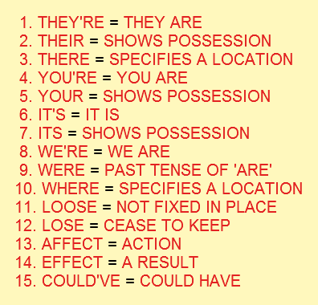
Punctuation Grammar
Grammar & Punctuation
Apostrophe | Semicolon | Colon | Comma
Replace letters that have been left out of words. Ex: is not=isn’t Shows possession. Ex: That is Sally’s bike. | Used to separate items in a complex list Ex: Mary needed 6 large, ripe tomatoes; 1 small, green pepper; 1 onion and some fresh basil. 2. Can be used to separate two short, closely related sentences. Ex: Mary loves to cook; she buys a new cookbook each week. | Most commonly used to introduce a list. Ex: I need to buy more ingredients: flour, sugar, milk, and eggs. | Is used to show the reader where to take a breath. Ex: We saw blue, red, purple, orange, and pink flowers. Ex: Mary wanted to go swimming, but she had just eaten.

